Slide 1
Digital Design and Computer Architecture
Course outcome 2

Slide 2
PROJECT TITLE
Design and Simulation of a Digital Access Card Verification System Using (2*1)Multiplexer

Slide 3
Presented by
1.Sai Hitesh – 2620030269
2. Hyder – 2620030257
3. Radhika – 2620030258
4. Akshith - 2620030282

Slide 4
Introduction
A Digital Access Card Verification System is a digital security system designed to control access to a protected area or system. Access is granted only when two conditions are satisfied:
The access card is valid.
The entered PIN is correct.
The system uses combinational logic and a 2:1 Multiplexer (MUX) to implement the required access-control logic.

Slide 5
Objectives
The objective of this project is to design a digital access card verification system that grants access only when the card is valid and the PIN is correct.
Specific Objectives:
Card Verification – Checks whether the access card is valid.
PIN Verification – Checks whether the entered PIN is correct.
Access Control – Grants access only when both conditions are satisfied.
Security – Prevents unauthorized access.
Digital Implementation – Demonstrates combinational logic using a 2:1 multiplexer.

Slide 6
Logic Design
Since, The system uses two inputs and one output:
Input A – Card Status:
0 = Invalid Card, 1 = Valid Card
Input B – PIN Verification:
0 = Incorrect PIN, 1 = Correct PIN
Output Y – Access:
0 = Access Denied, 1 = Access Granted
The required AND logic is implemented using a 2:1 Multiplexer

Slide 7
2:1 Multiplexer Logic
A 2:1 Multiplexer is used to implement the access-control logic.
The MUX connections are:
I₀ = 0 — Constant Logic 0
I₁ = B — PIN Verification
S = A — Card Status
Y = Access Output
When A = 0, the MUX selects I₀, which is 0. Therefore, access is denied.
When A = 1, the MUX selects I₁, which is B. Therefore, access depends on whether the PIN is correct.

Slide 8
Working
The card reader first provides the Card Status (A).
If the card is invalid, A = 0. The MUX selects I₀ = 0, so access is denied.
If the card is valid, A = 1. The MUX selects I₁ = B.
If the PIN is incorrect, B = 0, so access remains denied.
If the PIN is correct, B = 1, so access is granted.

Slide 9
Logisim Simulation
Place two input pins for Card Status (A) and PIN Verification (B).
Place a 2:1 Multiplexer.
Set Select Bits = 1 and Data Bits = 1.
Connect Constant 0 to I0.
Connect B (PIN Verification) to I1.
Connect A (Card Status) to the Select input (S).
Connect the MUX output to an output pin or LED.
Change the values of A and B and verify the truth table.

Slide 10
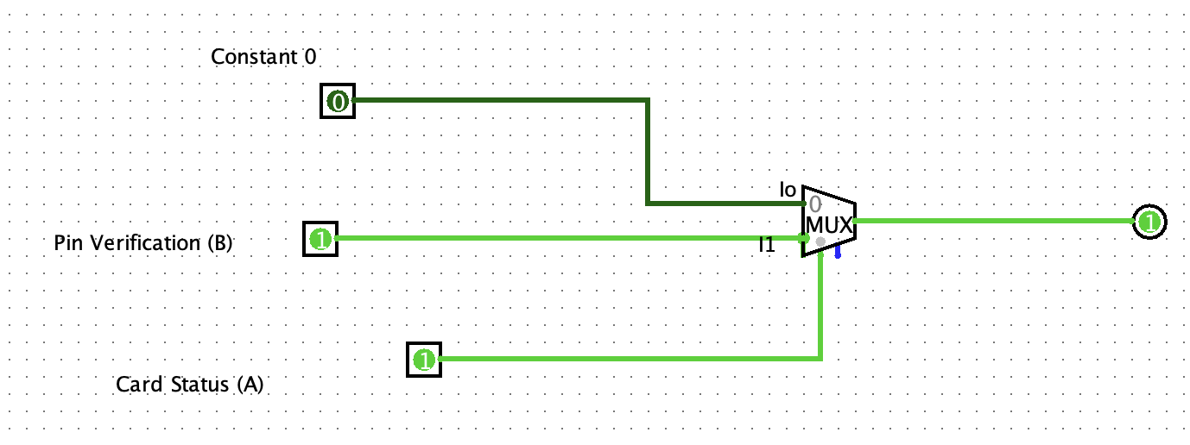
Logisim Diagram

Slide 11
Truth Table
A(Card Status) | B(Pin Verification) | Y(Access)
0 | 0 | 0
0 | 1 | 0
1 | 0 | 0
1 | 1 | 1

Slide 12
Boolean Expression
The required logic is:
Y = A · B
Where:
A = Card Status
B = PIN Verification
Y = Access
This represents AND logic because access is granted only when both conditions are true.

Slide 13
Expected Result
Street light turns ON when it is dark and motion is detected.
Street light remains OFF during daylight.
Street light remains OFF when there is no motion.
The 2:1 MUX successfully controls the street light based on the sensor inputs.
The circuit is successfully simulated and verified in Logisim Evolution.
The system helps reduce unnecessary power consumption.

Slide 14
THANK YOU

